Slide 1
PRICE THEM ~ FIFA 18
-Shubhashri A G (15PT32)

Slide 2



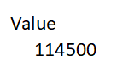
A SNEEK PEAK INTO THE DATA…

Slide 3
Common steps…
1.Extract top 20 principal components of the data
2.Divide the given data into train and test subsets :
Train-(0.7114732724902216 * nrow(dat))
3.Else step 2 is replaced by CROSS VALIDATION(10 FOLD)

Slide 4
Classifiers trained on
REGRESSION TREE
RANDOM FORESTS
XGBOOST
NEURAL NETS

Slide 5
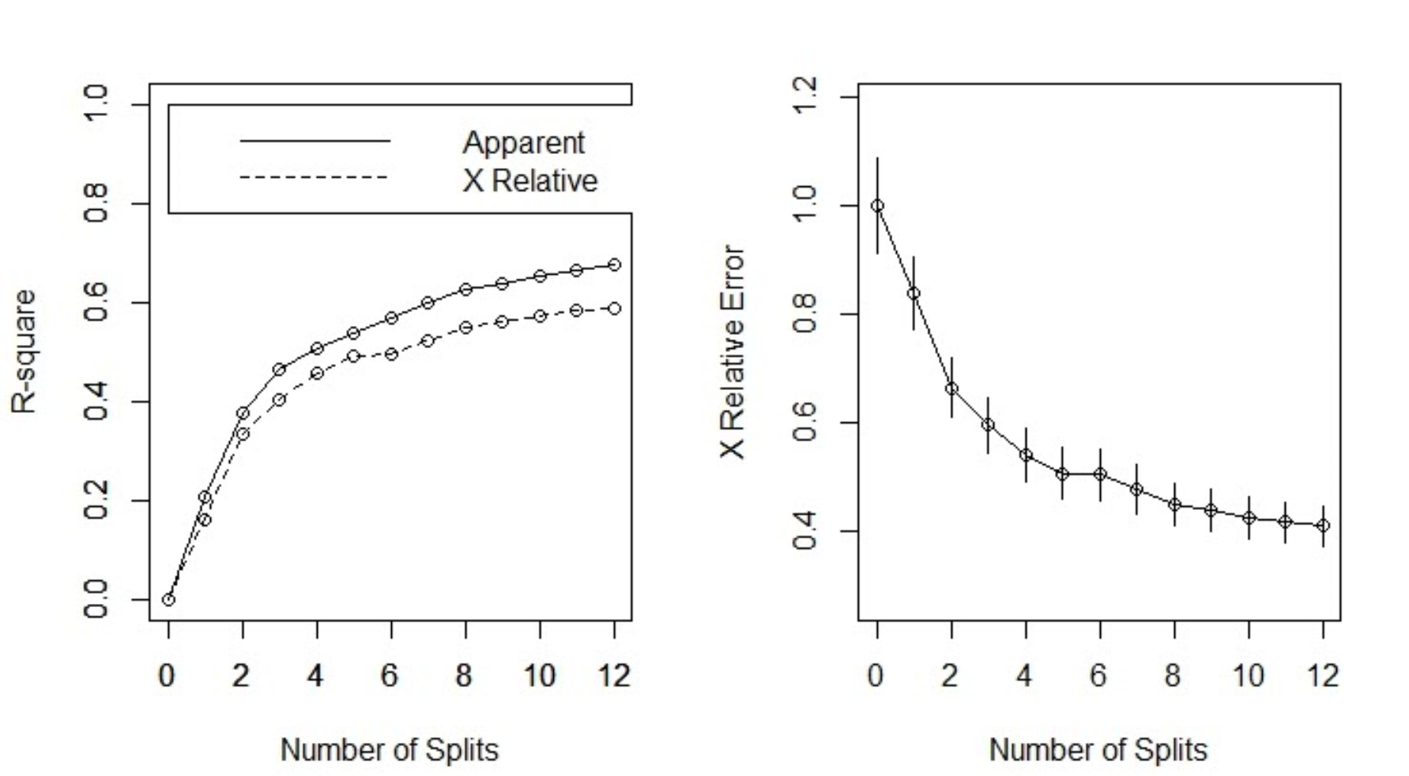
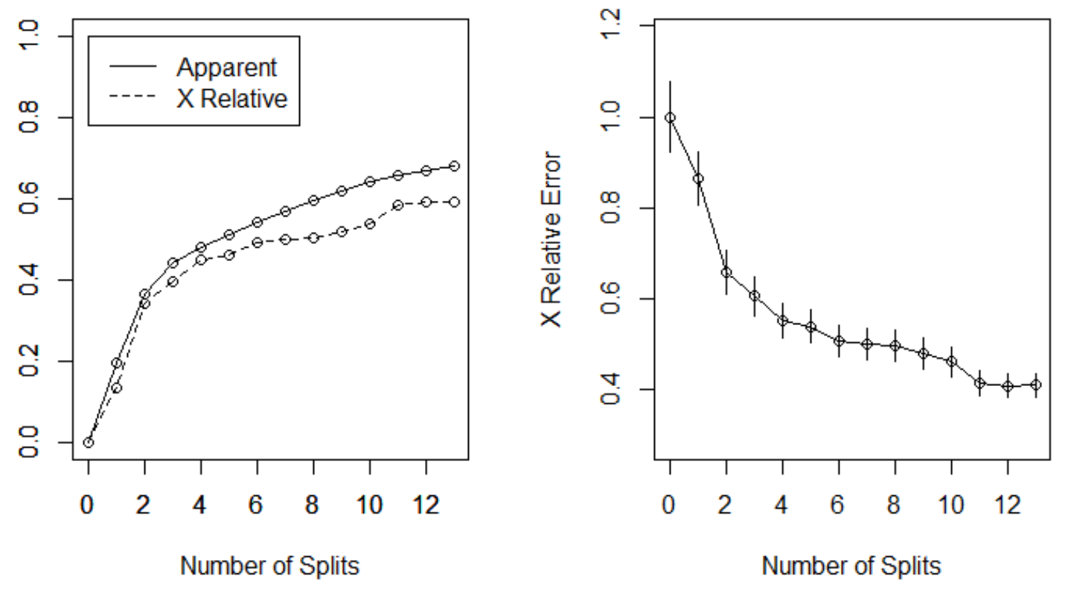

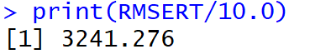
Regression tree

Slide 6
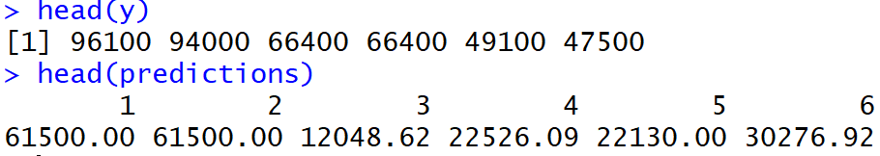
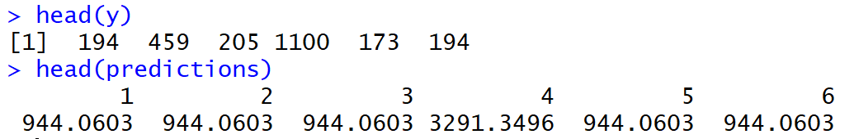
Predictions…

Slide 7
Other metrics in the prog.

Slide 8
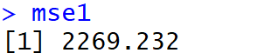
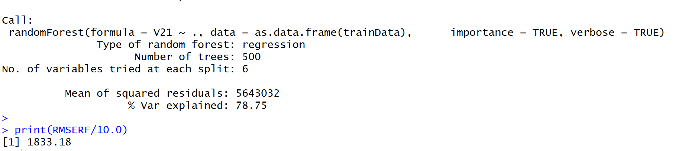
RANDOM FOREST

Slide 9
Predictions…

Slide 10
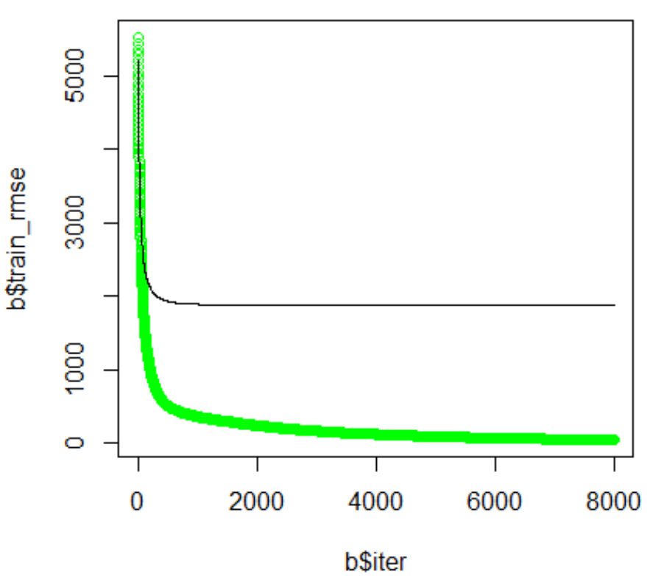
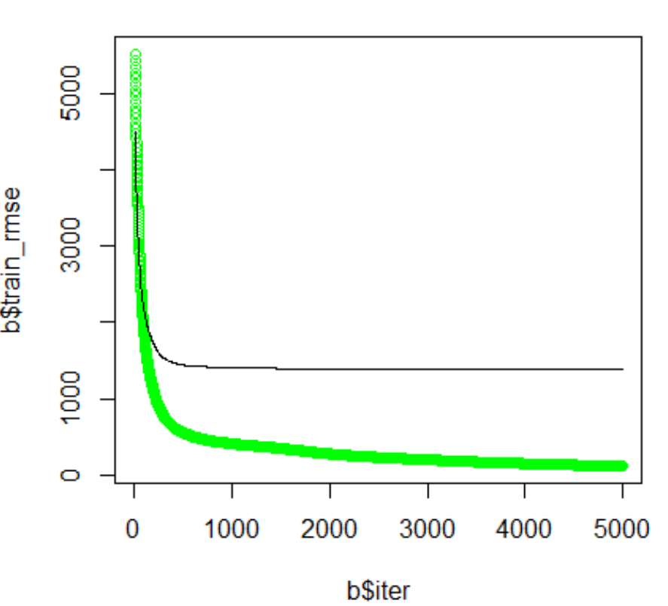
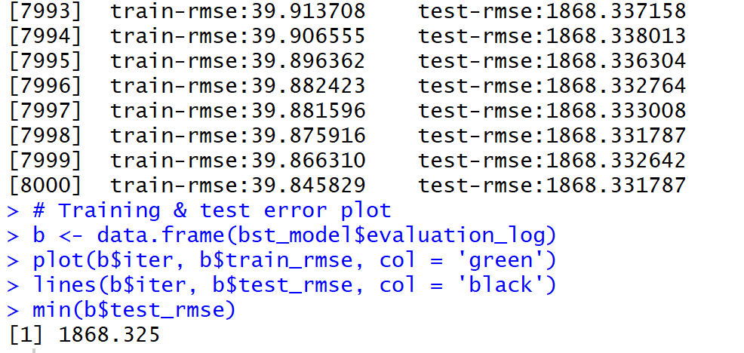
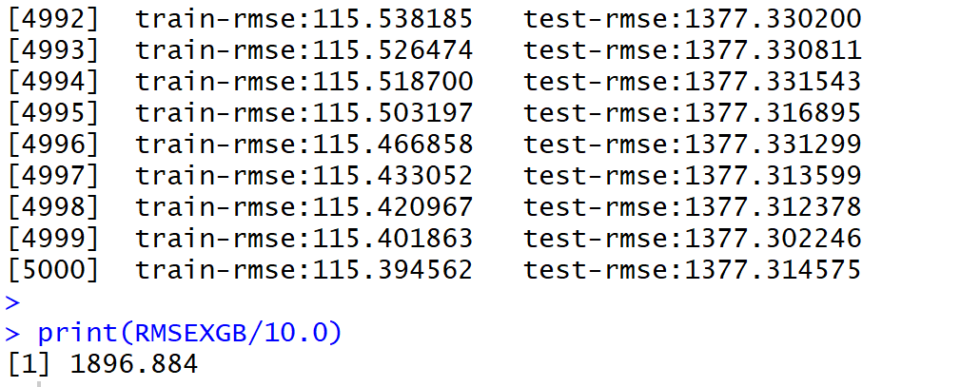
XGBOOST

Slide 11
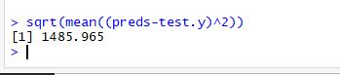
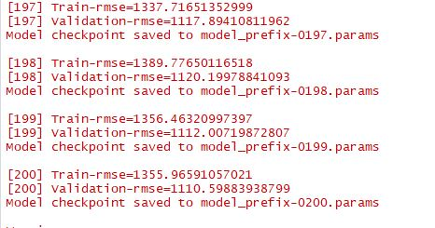
NEURAL NETS

Slide 12
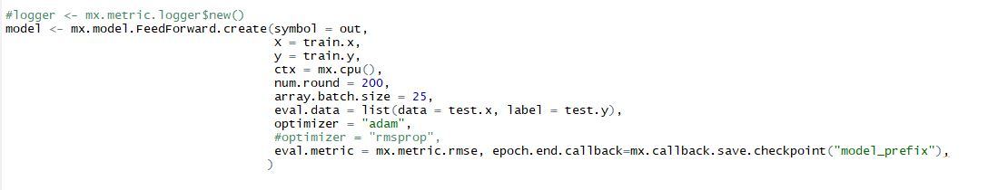
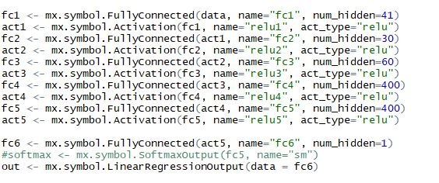
CONFIG…

